Slide 1
Introduction to Analyzing Data for Business Goals
ACP Data Analytics for Business

Slide 2
Introductions
Instructor Introduction
Student Introductions
Course Overview
Syllabus Review

Slide 3
Instructor Introduction
Yu Zhang
Email: yuz8@uci.edu
Experience

Slide 4
Student Introduction
Please share:
Your Name
Your Role
Why are you here?
What do you hope to learn?
What do you want to challenge in this course?

Slide 5
Introduction to Analyzing Data for Business Goals
Develop actionable plans from existing corporate data and initiatives to evaluate the effectiveness of current strategies
Collect, select, describe, profile, and prepare data from various sources for analysis
Validate and interpret the results of data analytics projects
Develop questions to use as frameworks for analysis projects by applying the four major types of analytics (descriptive, diagnostic, predictive, and prescriptive)
Effectively design, develop, and implement data analysis based on defined goals

Slide 6
Final Project – Data Strategy
Due on the last day of class
Create a data strategy for a business problem
Pick the industry of your choice
Leverage each of the four types of data analytics discussed in the course
Problem Outline:
Why the problem exists
What may happen in the future
Steps you would suggest to address and solve the problem.
Must include:
The plan: data preparation
The analysis: data exploration
The report: data storytelling

Slide 7
Final Project – Data Strategy…
Presentation:
Your strategy can be presented in any format that you feel best represents the industry and business problem.
Some examples are (but not limited to):
Infographics
Presentation
Paper
Website
….
Must look professional

Slide 8
Final Project – Stay on Track
These assignments are not graded.
They have due dates to help you stay on track with your final project.
Assignment 2a
Assignment 3a
Assignments 4
Assignment 5a
Assignment 7a

Slide 9
Introduction to Data Analytics and Data-Driven Decision Making
Introduction to Analyzing Data for Business Goals

Slide 10
Learning Goals
Explain how data analytics helps business drive actionable results
Select a data analytics project topic and evaluate data associated with said topic
Define the four types of data analytics
Identify standard processes for data analytics

Slide 11
What is Data Analytics (DA)?
Use data to answer business questions
Gain insight
Support business decisions

Slide 12

Opinion vs Data
"If we have data, let’s look at data. If all we have are opinions, let’s go with mine."
– Jim Barksdale, former CEO of Netscape Communications Corporation.

Slide 13

The goal
"The goal is to turn data into information, and information into insight."
– Carly Fiorina, former chief executive of Hewlett-Packard Company or HP.

Slide 14
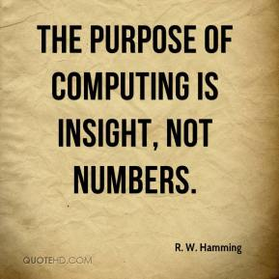
But why?

Slide 15



What is In$ights?

Slide 16
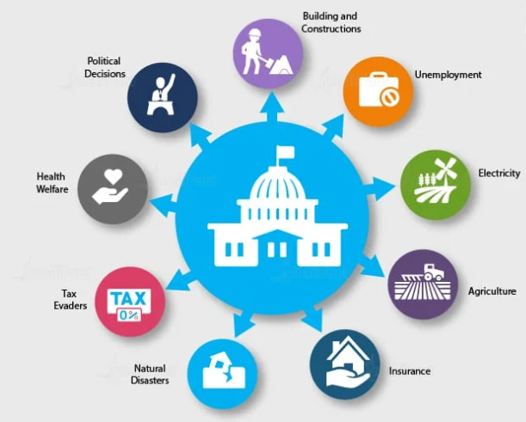
Data Analytics Applied Across Industries
Government Sector

Slide 17
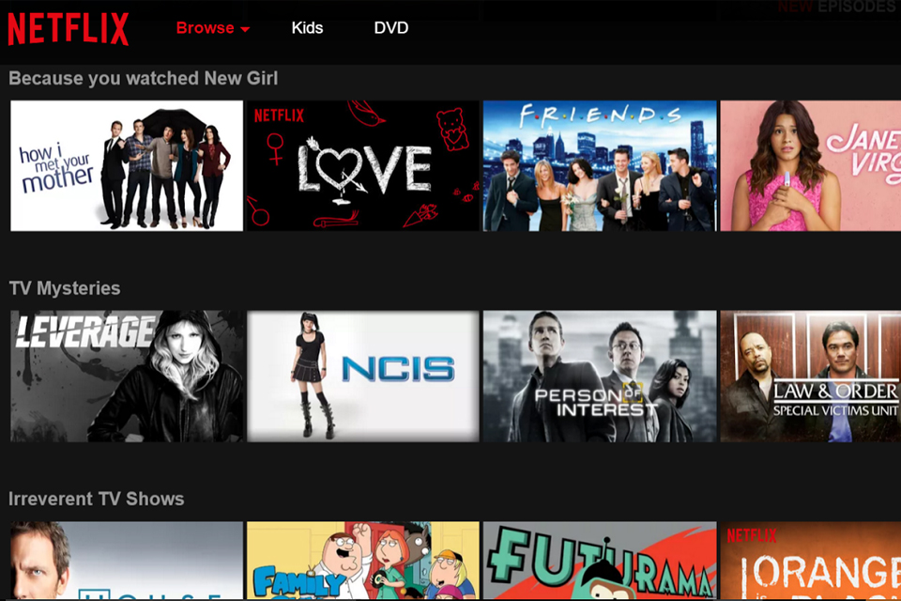
Data Analytics Applied Across Industries
Entertainment Industry

Slide 18
Example Questions Across Industry
Field | Descriptive Analytics | Diagnostic Analytics | Predictive Analytics | Prescriptive Analytics
Healthcare | How many patients went to the hospital/clinic last week? | Why did these patients go to the hospital? | Which patient is likely to need hospitalization? | Extra home treatment to prevent visits
Life science | What are the total medicines available by pharmaceuticals? | Why do we not have more medicines or pharmaceuticals? | Which pharmaceutical is likely to monopolize the production of medicines? | Increase the number of pharmaceuticals and medicines
Finance | Where was the stock market in the last 6 months? | Why was the stock market that high/low? | What will the level be for the stock market in the next 6 months? | Reduce downside risk by diversifying a portfolio
Politics | Who was elected last? | Why were they elected? | Who will be elected next? | Increase voter education to reduce downside societal impact
Education | How many students are learning online? | Why are they taking courses online? | How many more courses are needed to support them? | Increase the number of courses
Non-profit | How are non-profits independent? | Why are they effective? | How many more non-profits can be created? | Decrease barriers to creating non-profits
Human rights | What is the number of refugees in the world? | Why are there so many refugees? | What are the likely future sources of refugees? | Reduce colonialism, imperialism, 'isms and let people live

Slide 19
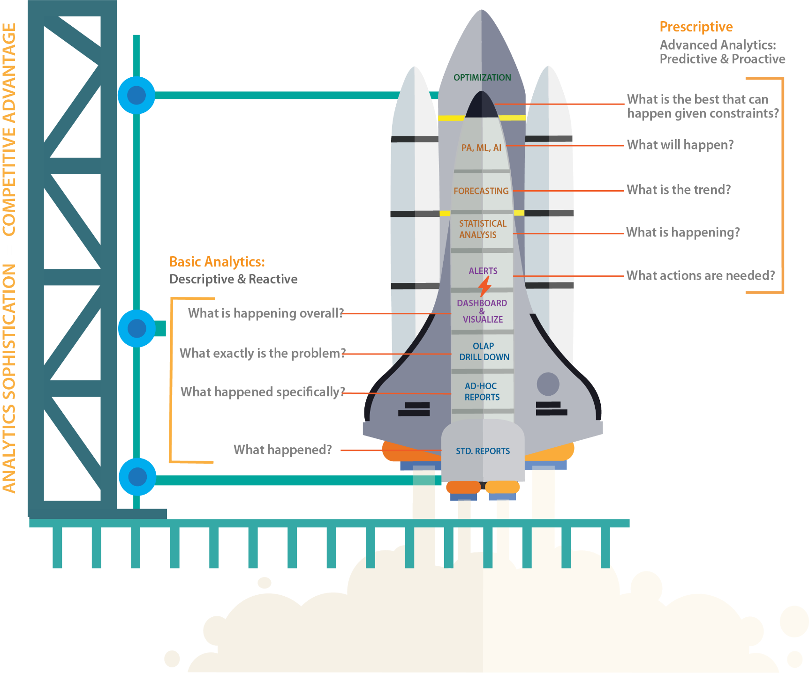
Data Science Operating Model
http://analytics.rsystems.com/wp-content/uploads/dlm_uploads/2017/04/R-Systems_Analytics-Sophistication_Thought_Leadership_Whitepaper.pdf

Slide 20
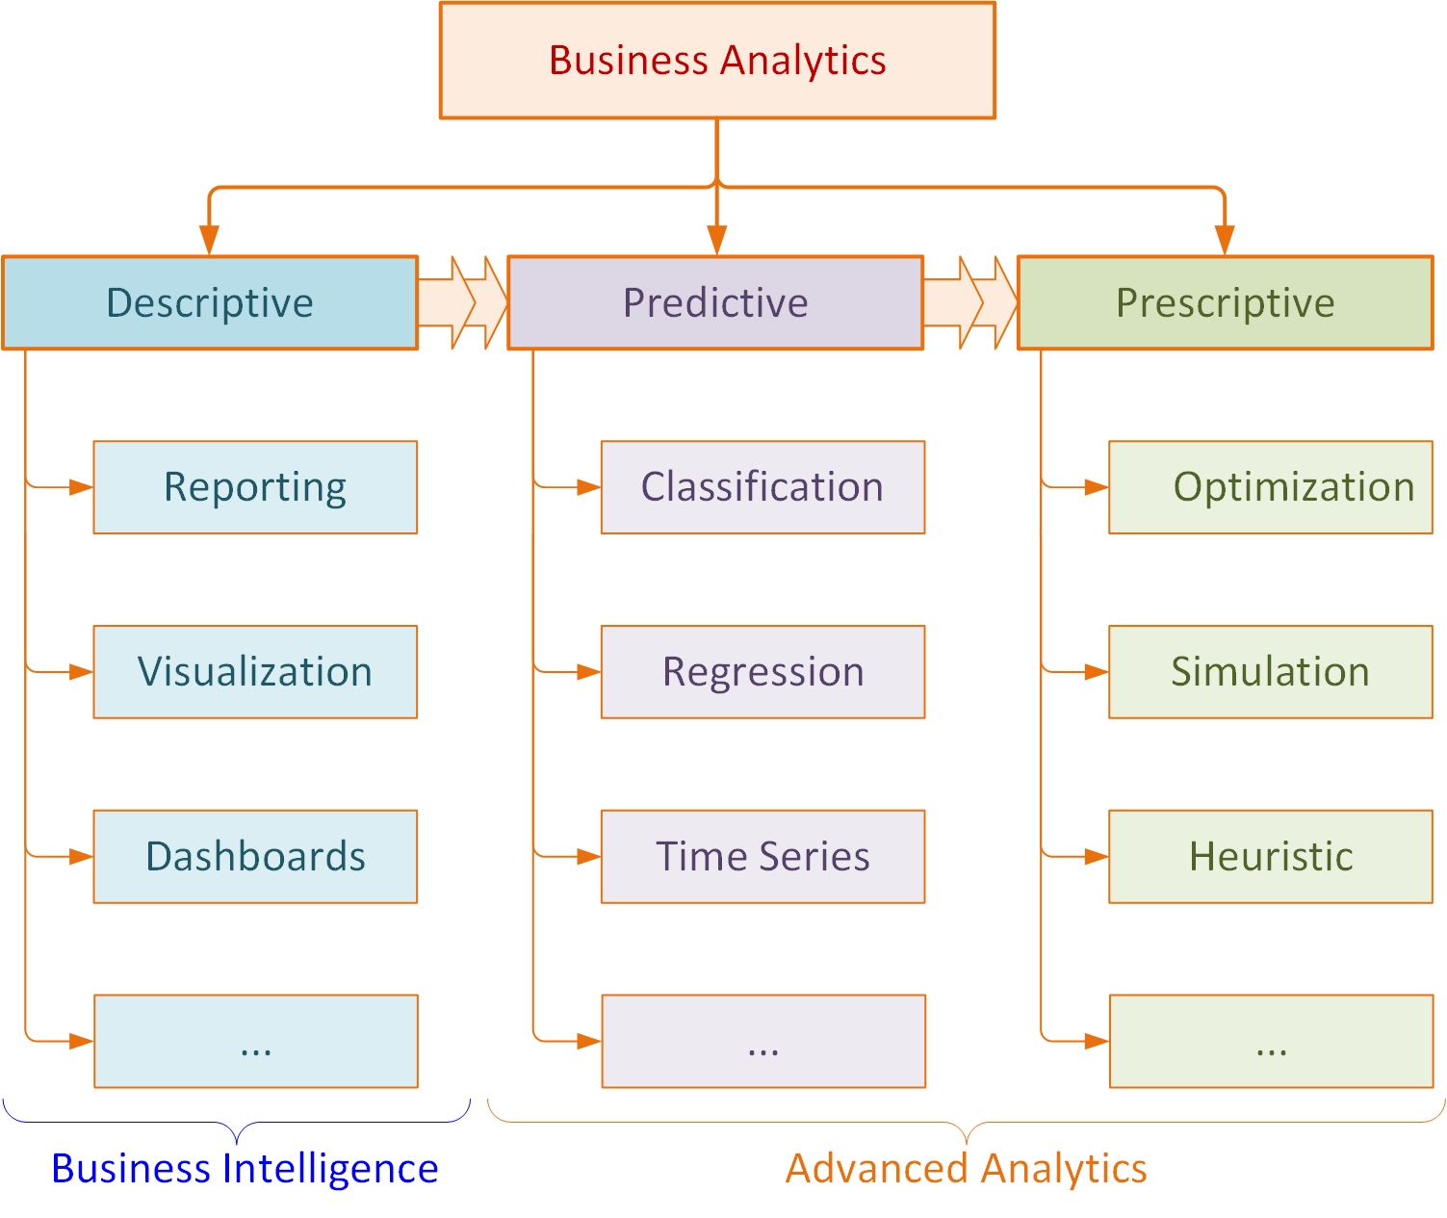
A Simple Taxonomy for Analytics

Slide 21
Common Terminology in DA
Data governance: The process of establishing how data should be used and ensuring data integrity
Outlier: A value that is significantly different from the general distribution
Python: A computer programming language
R: A computer programming language used often for statistical computing
Quantile: A group of objects classified with similar characteristics
Correlation: The degree to which two variables move together, usually expressed by a correlation coefficient that ranges between -1 and 1
Data scientist: A professional with a high degree of technical skill and knowledge (often computer science, statistics, design skills)
Data engineer: An individual who maintains the systems that data scientists and data analysts use, and sometimes participates in the analysis
Algorithm: Repeatable steps used to solve a problem
Unsupervised learning: A type of machine learning in which outputs are unlabeled
Supervised learning: A type of machine learning in which outputs are labeled

Slide 22
Final Project – Data Strategy
Start thinking of a business problem to solve
Anything to share?
Take part in Module-1 Discussion

Slide 23
Basic DA Workflow
Data Preparation
Analysis and Data Exploration
Presenting and Communicating Analytics Results

Slide 24
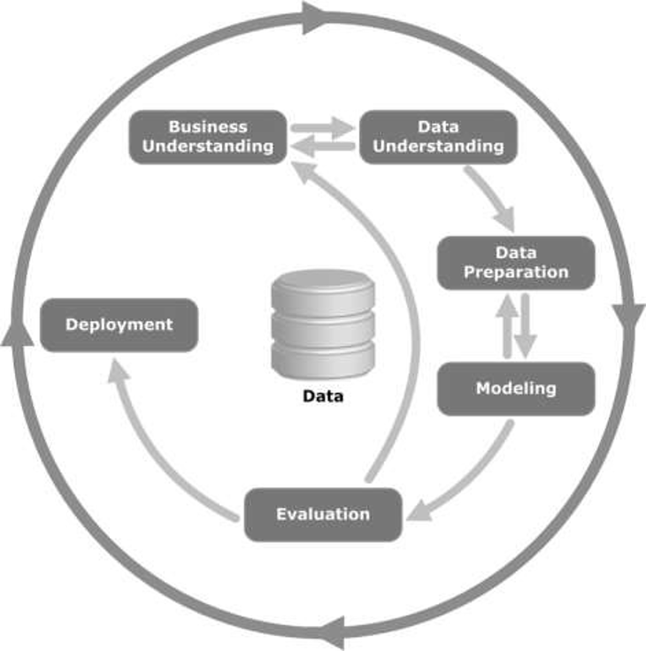
CRISP-DM Methodology

Slide 25
Cross-Industry Process for Data Mining
Step 1: Business Understanding
Gaining a through understanding of the business domain
Especially important and challenging for consultancy type business practices
Use of both documents and domain experts
Listen carefully (but do not believe everything)
Relies on not only documented official policies and processes but also unwritten, hidden practices, rules and regulations
The outcome is a “structure problem” for analytics

Slide 26
Cross-Industry Process for Data Mining
Step 2: Data Understanding
Is the relevant data available to study and potentially solve the structured problem?
Assessing the match between the problem and the data
Data often comes from a variety of sources and in a variety of types and formats
It relies on a thorough understanding and knowledge of the domain terminology and language (the lingo)
Need to identify the synonyms and homonyms
Data may need to be enhanced with outside sources (both public/free and private/paid)

Slide 27
Cross-Industry Process for Data Mining
Step 3: Data Preparation
Also called data preprocessing
The real-world data is often dirty, inconsistent, noisy, redundant, and incomplete
The goal is to produce an analytics ready data set
Often involves “feature engineering” practices to create new and more descriptive variables
Also involves data conversion/transformation and standardization
From numeric to nominal and vice versa
The outcome is often an analytics ready flat file

Slide 28
Cross-Industry Process for Data Mining
Step 4: Model Building
Involves experimentation of different models
Each model type has its pros and cons
No way to know the best model without experimentation
Some models like numbers some like sets
Each model also has a set of parameters to “optimize”
Model building and testing goes hand-in-hand
Model assessment involves more than just accuracy
Use of cross validation is a good practice
Model interpretability is also important
Use of model ensembles is a common practice

Slide 29
Cross-Industry Process for Data Mining
Step 5: Testing and Evaluation
Not the same as model evaluation
The focus is on the match between business problem and the results of the built models
Do the results address the business problem from Step 1
The feasibility, practicality and value proposition of the produced model is critically assessed
The requirements of the business problem may suggest a solution other than the best identified in the previous step
Sometimes interpretability or deployability may be more important than predictive accuracy

Slide 30
Cross-Industry Process for Data Mining
Step 6: Deployment
Means “putting the solution in use”
Some deployments are one-time solutions
There is no need for repeated use
Most deployments lead to perpetual use
As a decision aid tool (i.e., decision support system)
Complex models are usually harder to deploy
Deployment on the cloud is a current trend
Deployed models need to be continuously assessed for accuracy, relevance, and value

Slide 31
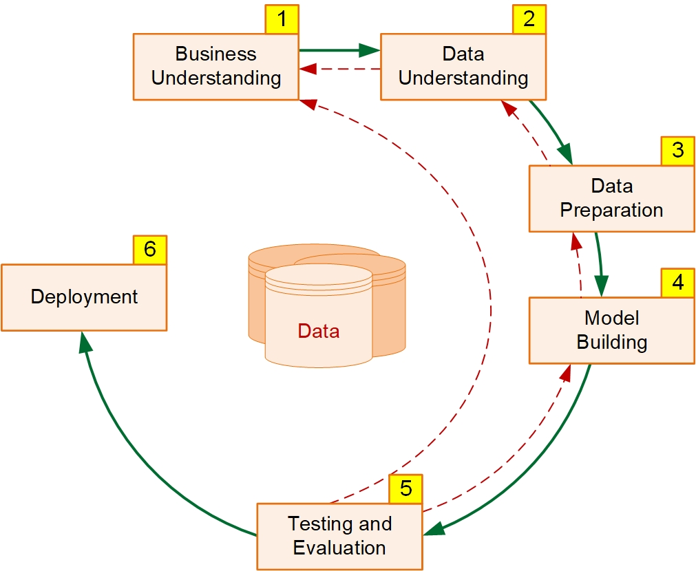
Cross-Industry Process for Data Mining
Review of CRISP-DM:
Most steps have feedbacks (like an experimental refinement)
First three steps accounts for more the 80% of the total project time
Some steps requires soft skills some requires hard skills

Slide 32
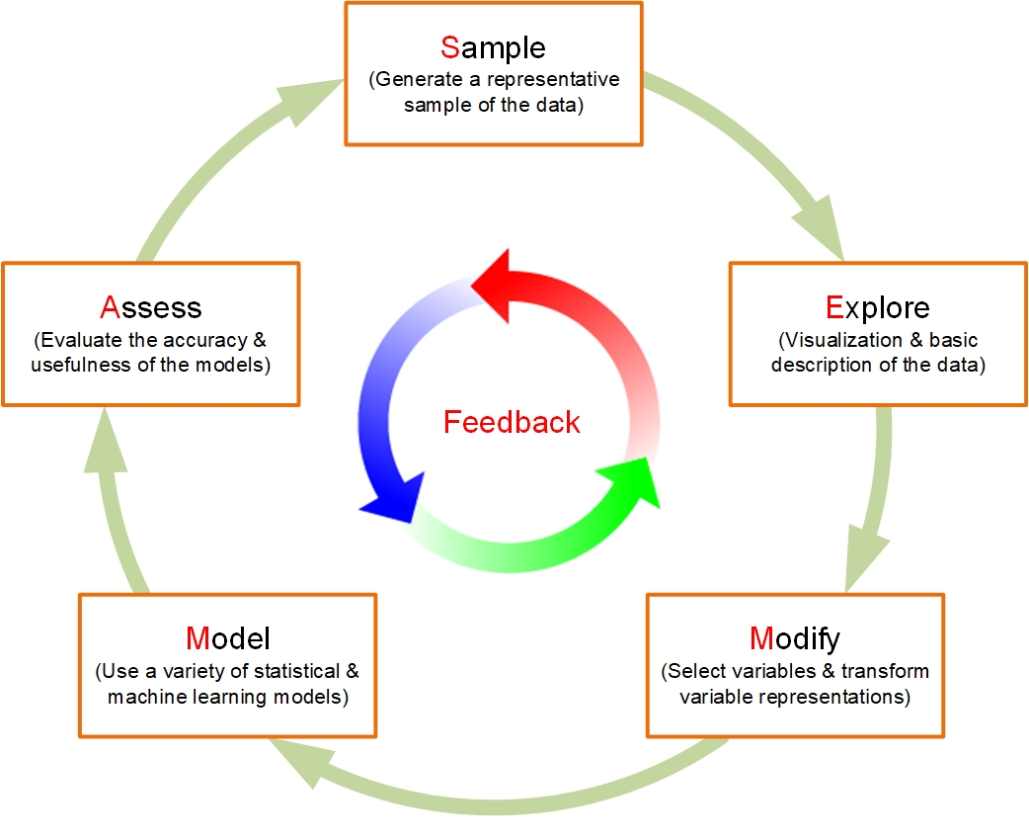
Sample, Explore, Modify, Model, Assess
SEMMA process is developed by SAS Institute
SAS Institute is one of the largest analytics companies in the world
Seems to fit better to statistical analysis than data mining
Usually practiced by SAS customers

Slide 33


What kind of sport is Data Science?

Slide 34
Skills of Data Scientists
Business and domain expertise
Identifying questions feasible and worthy of data science solutions
Communication (both technical and non-technical) and project/talent management
Expertise in machine learning algorithms
Knowledge/expertise in software engineering
Expertise in data storage (both traditional relational databases and NoSQL databases) and data engineering (ETL tools)

Slide 35
Ethical Considerations & Data Privacy
The Target story …
Identification of people’s personal/private characteristics for marketing/sales purposes
Amazon’s AI based recruiting/hiring practices
Bias against female applicants based on the historical dominance of men
Consumer data has become a commercially traded commodity by the big Internet companies
Data/customer data privacy laws (GDPR in EU)
Data Science AI stealing jobs!

Slide 36

Q&A
What questions and comments do you have?

